Slide 1


Computer Organisation & Architecture: Register Transfer
Session No. : 3 Course Name: Computer Organisation & Architecture
Course Code: R1UC305T
Instructor Name: Dr. Brijesh Kumar Singh Duration: 50 mins.

Slide 2


Session Outline
Review of the key concepts of previous session
Learning Outcomes
Opening Question
Register Transfer
Learning Activity-1
Block Diagram Showing Register Transfer
Learning Activity-2
Conclusion

Slide 3
Review of the key concepts of previous session
Operations executed on data stored in registers are called microoperations and symbolic notation used to describe the microoperation transfers among registers is called a register transfer language.
A register transfer language is a system for expressing in symbolic form the microoperation sequences among the registers of a digital module.
Register transfer language is a convenient tool for describing the internal organization of digital computers in concise and precise manner.

Slide 4

At the end of this session, students will be able to
Learning Outcome 1: Understand the block diagram showing Register Transfer
Learning Outcome 2: Explain how data transfer takes place between the registers.

Slide 5
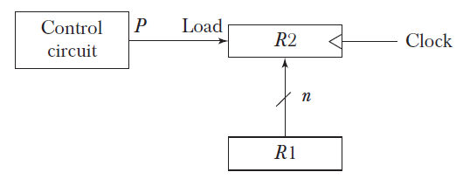
Opening Question
Observe figure and describe what you observe.

Slide 6
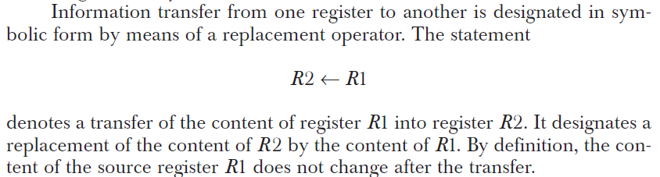
Register Transfer
Register Transfer describes about transfer of content (information) from one register into other register.
Symbolic Representation Register Transfer:

Slide 7
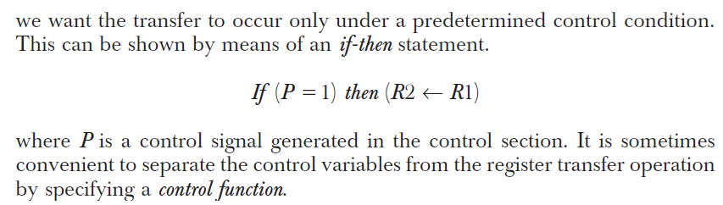
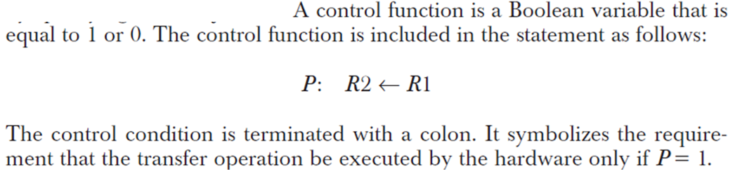
Register Transfer Continued - - - - - - -

Slide 8


Learning Activity 1: Think-Pair-Share
What is meaning of following register transfer statement
Notes:
For 5 mins Concept

Slide 9

Reflection of Learning Activity 1
Notes:
For 5 mins Concept

Slide 10
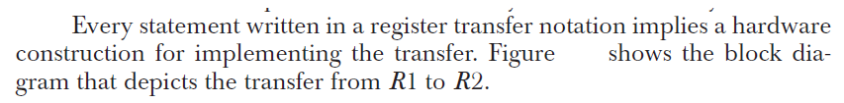
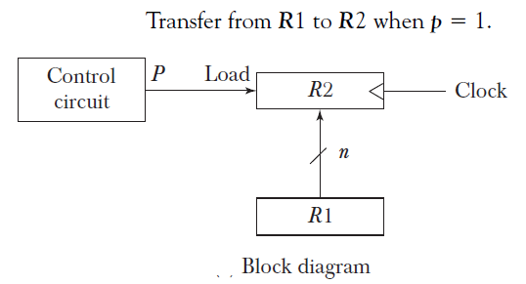
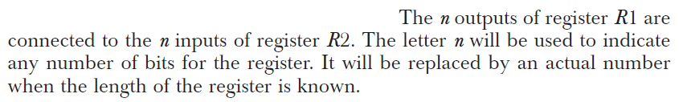
Block Diagram Showing Register Transfer

Slide 11

Block Diagram Showing Register Transfer Continued - - -

Slide 12
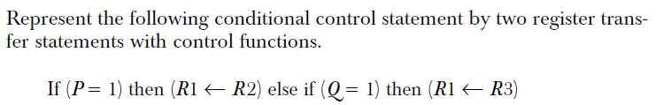
Learning Activity 2: Think-Pair-Share
Notes:
For 5 mins Concept

Slide 13

Reflection of Learning Activity 2
Notes:
For 5 mins Concept

Slide 14
Conclusion
Register Transfer is foundation for describing how instructions are executed.
Control circuit plays a important role in register transfer.
Every machine instruction (like ADD, SUB, MOV) can be expressed as a sequence of register transfers.
Notes:
5 mins

Slide 15
Attainment of LOs
Learning Outcome 1: Understand the block diagram showing Register Transfer
Learning Outcome 2: Explain how data transfer takes place between the registers.

Slide 16

Provide your Reflection for Today’s Session

